Slide 1
US Decision Science
Potential Re-tiering discussion
NS sales forces
February 2007

Slide 2
Zyprexa Potential: Zyprexa or AP decile?

Slide 3
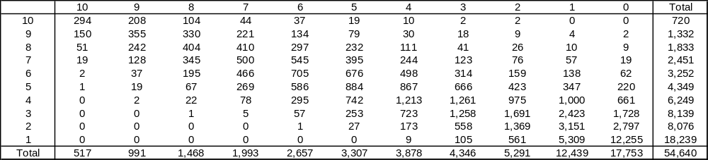
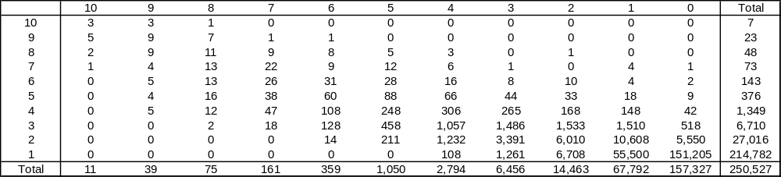
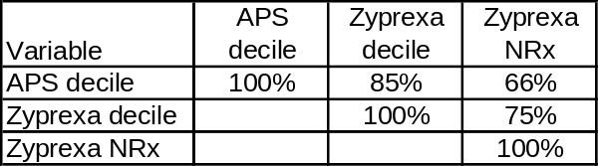

APS versus Zyprexa decile based on specialty group
Psych
Zyprexa decile
APS decile
76% of APS 3-10 MDs are Psychs
PCP
Zyprexa decile
APS decile
66K of Zyprexa writers are PCPs and low writers for both Zyprexa and APS
(Zyprexa 1 and APS 1-2)
Psych
Correlations
PCP
APS and Zyprexa decile are more correlated for Psychs compared to PCPs
Notes:
Zyprexa and APS decile based on 12 months TRx ending Dec’06, NRx is also 12 mo NRx ending Dec’06
MD universe are APS 1-10 MDs in NS or PC quota pool for Q4’06

Slide 4
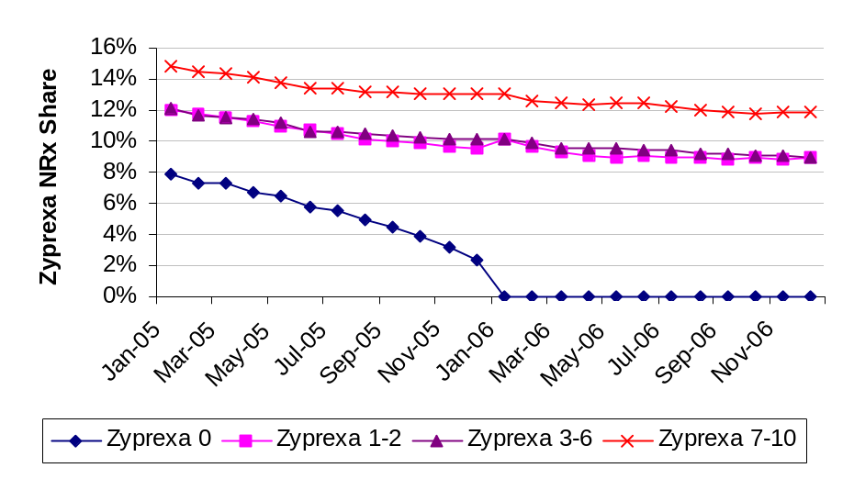
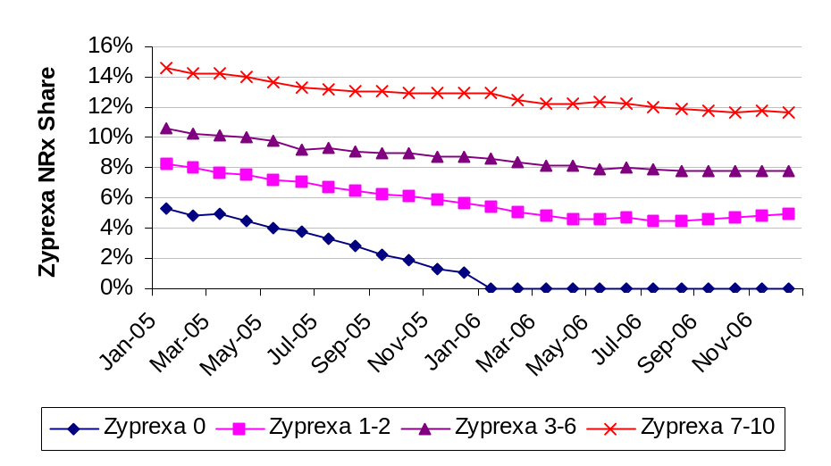
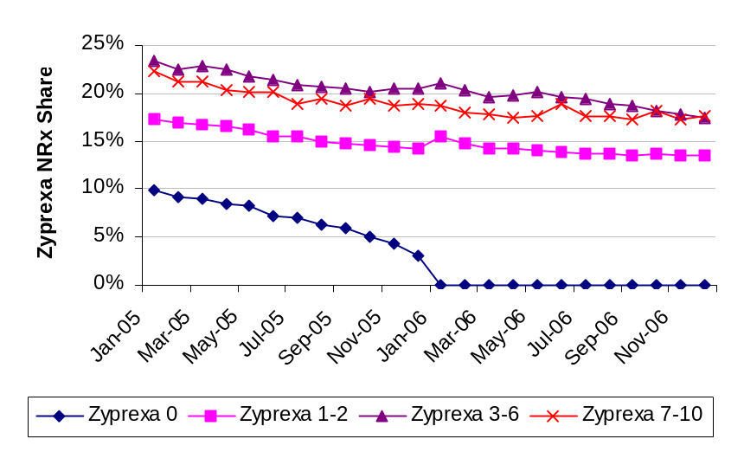
Trend of Zyprexa share by Zyprexa decile group
Overall
The gap in share between different Zyprexa decile groups doesn’t appear to be changing much over time
Does this mean that it will be hard to move low Zyprexa writers based on potential?
Psych
PCP
Notes:
1. Zyprexa and APS decile based on 12 months TRx ending Dec’06

Slide 5
NS Targeting Assessment

Slide 6
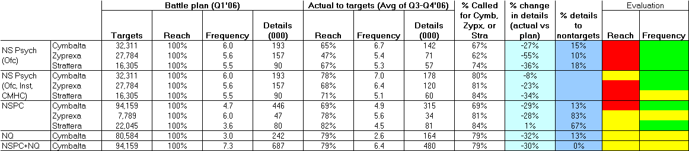
Battle Plan vs. Actual (All NS Sales Forces)
  Compared to the battle plan
    Significant gap in reach for all products for NS Psych Ofc reps
    Significant gap in reach for Zyprexa even when contacts from NS Psych, CMHC and NSABSO are considered
    Though 81% of Zyprexa targets were called on, only 68% received a Zyprexa detail
    Significant gap in reach for Cymbalta in NSPC (driven more by low reach in DPNP)
Notes:
Battle plan groups based on NS Q1’06 Business Rules Document
Definition of groups have been updated to use the decile data from Nov’06 and NSABSO laptop tier from Dec’06
MD universe used for assessment are MDs who are either in NS Psych/NSPC laptop of Dec’06 or were in the original target list sent in Dec’05

Slide 7
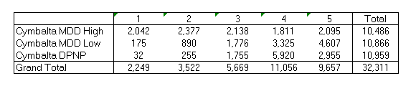
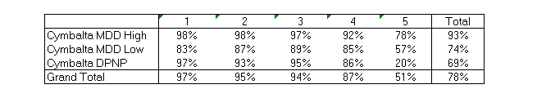
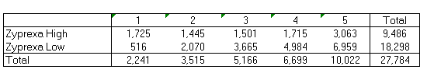
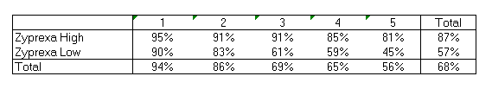
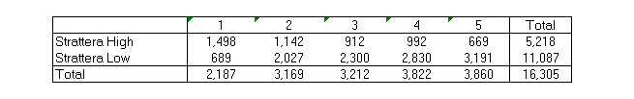
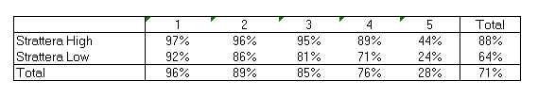
Target segments versus Tier (NS Psych Ofc)
Targets based on battle plan
% Targets reached by NS Psych Ofc, CMHC and NSABSO
Cymbalta
NS Psych Ofc Tier (Dec’06 laptop)
NS Psych Ofc Tier (Dec’06 laptop)
Zyprexa
NS Psych Ofc Tier (Dec’06 laptop)
NS Psych Ofc Tier (Dec’06 laptop)
Strattera
NS Psych Ofc Tier (Dec’06 laptop)
NS Psych Ofc Tier (Dec’06 laptop)
  Significant number of targets are in Tier 5 of NS Psych Laptop
  Are the targets in Tier 5 since they are difficult to reach (as seen by low reach compared to tier 1-4) or the other way around?

Slide 8
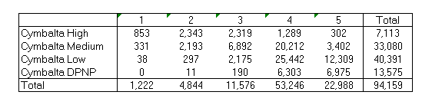
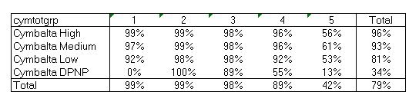


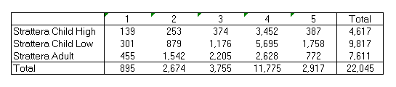
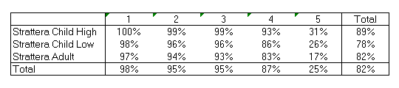
Target segments versus Tier (NSPC)
Targets based on battle plan
% Targets reached by NSPC,NQ
Cymbalta
NSPC Tier (Dec’06 laptop)
NSPC Tier (Dec’06 laptop)
Zyprexa
NSPC Tier (Dec’06 laptop)
NSPC Tier (Dec’06 laptop)
Strattera
NSPC Tier (Dec’06 laptop)
NSPC Tier (Dec’06 laptop)
  Significant number of targets are in Tier 5 of NSPC Laptop
  Are the targets in Tier 5 since they are difficult to reach (as seen by low reach compared to tier 1-4) or the other way around?

Slide 9
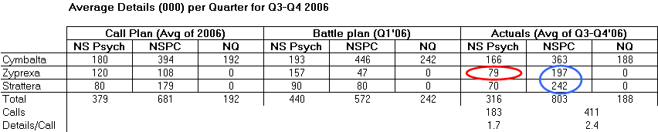
Comparison to Call Plan Assumptions
  Battle plan goals were significantly higher than call plan assumptions for all sleeves
  Actual details were close to the call plan assumptions, with two exceptions
    NSPC delivered more Zyprexa and Strattera details than expected (details/call >1.5)
    NS Specialty delivered fewer Zyprexa details than expected
      In part, this is a targeting issue

Slide 10
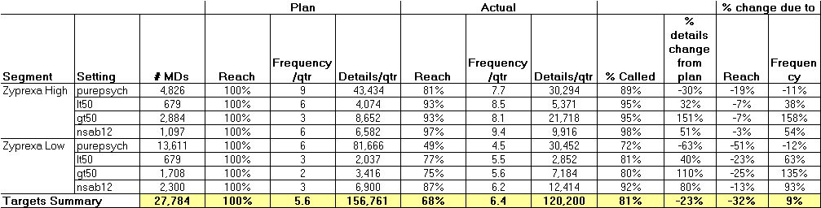
Zyprexa in NS Psych (Ofc, CMHC, and NSABSO)
  The detailing shortage was mostly on medium-value customers office based MDs
  72% of these MDs were called on, but only 49% received a Zyprexa detail

Slide 11
Recommendations
Optimal isn’t too far off from the current battle plan goals for each product customer group, but battle plan deviates from the call plan and actual details
A potential issue is the coordination of goals for each product into a portfolio-based approach
Recommend using APS TRx as the primary proxy for Zyprexa potential in NS Specialty, and a combination of Zyprexa Rx and AP TRx in PC - should restrict customers to Zyprexa Rxers
Recommend retargeting (or retiering) using a product-oriented tiering approach – the customers selected would be the same as a pure portfolio-based approach, but with different tiering
Next step analytically would be to document business rules, and evaluate the extent of the retargeting effort needed (build a target list & compare to current)

Slide 12
Targeting Assessment – Backup

Slide 13
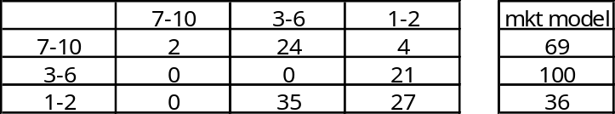
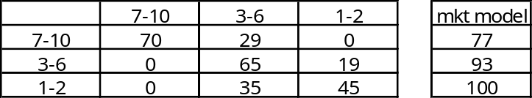
Detail responsiveness by APS and Zyprexa decile group
Two models of detail response
  Market model - Responsiveness using APS decile groups
  Market Product model - Responsiveness using a combination of APS and Zyprexa decile
Relative Responsiveness
When APS decile is used is much higher than when Zyprexa decile is used in combination with APS decile
This is more pronounced for Psychs compared to PCPs
This suggests that we should be careful about targeting customers solely on the basis of higher Zyprexa TRx – higher APS is a better approach
Market-product model
Market model
Zyprexa decile
APS decile
Psych
Market-product model
Market model
Zyprexa decile
APS decile
PCP
Notes:
Zyprexa and APS decile based on 12 months TRx ending Dec’06
Universe are MDs in APS 1-10 and in NS or PC quota pool for Q4’06

Slide 14
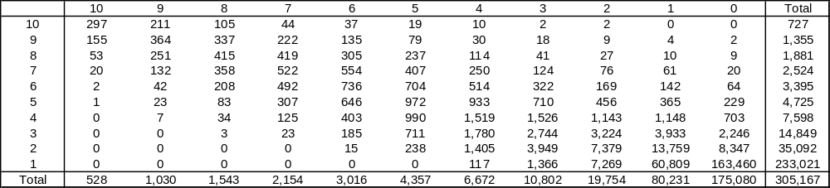
APS decile versus Zyprexa decile
Zyprexa decile
APS decile
Choosing APS versus Zyprexa decile has implications on universe considered by the brand as key players
  Choosing APS 1-10 implies a universe of 305K MDs
  Choosing APS 3-10 implies a universe of 37K MDs
  Choosing Zyprexa 1-10 implies a universe of 130K MDs
Notes:
Zyprexa and APS decile based on 12 months TRx ending Dec’06
Universe are MDs in APS 1-10 and in NS or PC quota pool for Q4’06

Slide 15
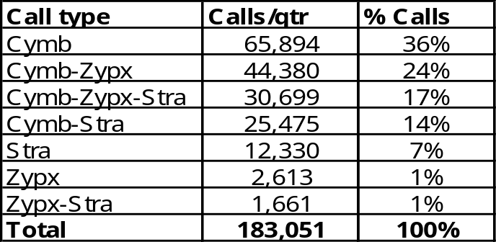
Zyprexa in NS Psych Ofc
  Most calls (57%) did not have a Zyprexa detail
  A Cymbalta detail was delivered in 91% of calls
  Possible issues due to incentive weights?
  A reasonable portion of details went to non-targets (10-15%)

Slide 16
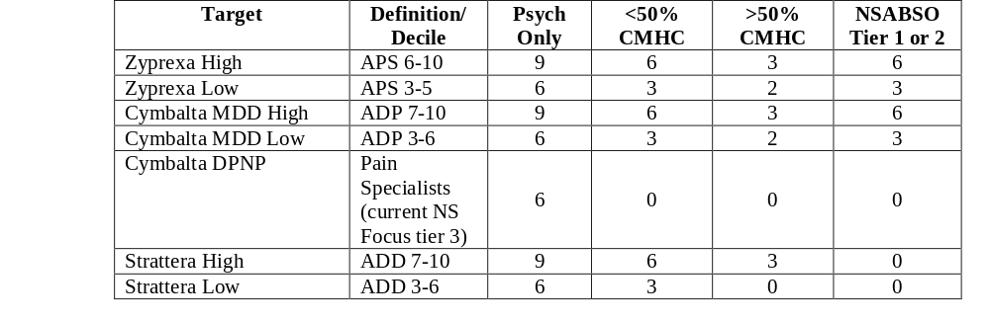
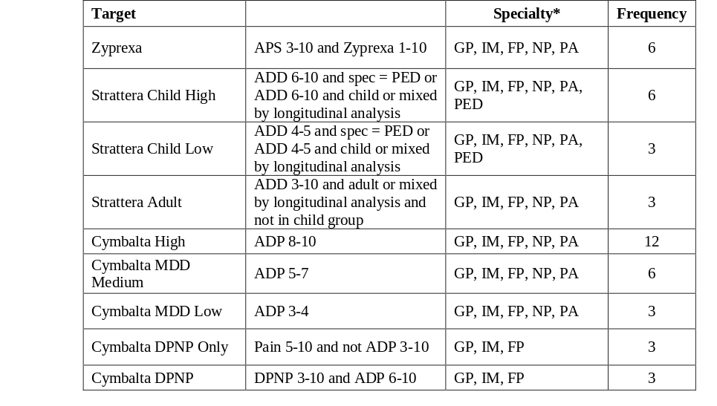
NS battle plan
Psych
Battle plan had product specific goals
Latest data (where available) is used to redefine the target segments
  Decile based on 12 mo TRx ending Nov’06
  Cymbalta DPNP targets as defined by brand for Q1’06 implementation
  NSABSO tier based on Dec’06 laptop
  % CMHC based on data from 2005
PCP
Notes:
This is the NS Q1’06 battle plan (page 12 of business rules document)

Slide 17
NS battle plan for tier specific goals
NSPC
NS Psych
Targeting -based on NS portfolio
Tier 1 Customers: 21-24 total details/qtr
Tier 2 Customers: 15-18 total details/qtr
Tier 3: Customers: 9-12 total details/qtr
Tier 4: Customers: 3-6 total details/qtr
No more than 2 NS Lilly representatives/customer regardless of setting
Targeting-based on NS portfolio
Tier 1Customers: 24-27 total details/qtr
Tier 2 Customers: 18-21 total details/qtr
Tier 3 Customers: 12-15 total details/qtr
Tier 4 Customers: 6-9 total details/qtr
No more than 2 NS Lilly representatives/customer regardless of setting
Frequency –based on all NS sales forces
Tier 1: 16 calls/quarter/customer
Tier 2: 12 calls/quarter/customer
Tier 3: 8 calls/quarter/customer
Tier 4: 4 calls/quarter/customer
+80% of customers should be at or above call goal
9 calls per day
Except Pediatricians who will receive 1 detail; all others receive 3 details
Frequency -based on all NS sales forces
Tier 1: 18 calls/quarter/customer
Tier 2: 14 calls/quarter/customer
Tier 3: 10 calls/quarter/customer
Tier 4: 6 calls/quarter/customer
+80% of customers should be at or above call goal
8 calls per day
Child Psych and DPNP Only Targets receive1 detail; all others receive 2 details
Notes:
Battle plan for FQ4’06 and FQ1’07 received from Sales Operations

Slide 18
MD universe used for targeting assessment
NSPC
PC quota pool Q4’06
(ADP, APS, ADD)
Dec’06 NSPC laptop
534K MDs
MD universe for generating NSPC Acorn Q1’06 list
NS Psych
NS quota pool Q4’06
(ADP, APS, ADD, DPNP)
Dec’06 NS Psych laptop
96K MDs
MD universe for generating NS Psych Acorn Q1’06 list

Slide 19
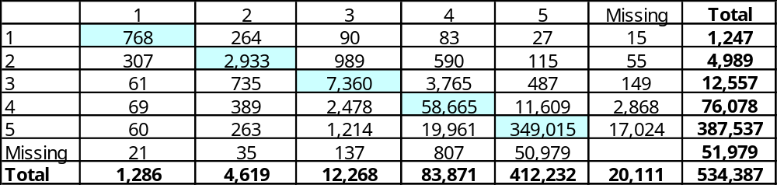
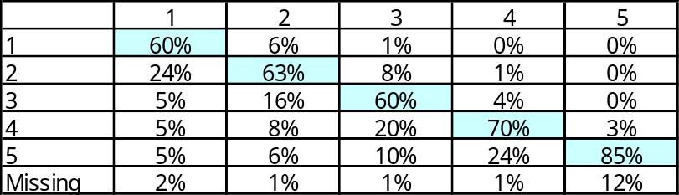
Recommended vs Actual Tier (NSPC)
Jan’06 universe
Current laptop
universe
Recommended 1-4
Current 1-4
52K
462K
20K
22K
80K
15K
MD count
Recommended tier
Current tier
% Movement from recommended tiers
Recommended tier
40% of tier 3 MDs have been re-tiered
Current tier

Slide 20
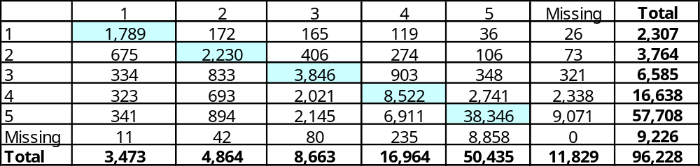
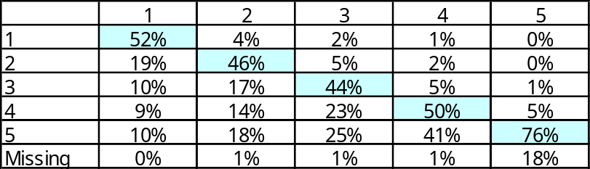
Recommended vs Actual Tier (NS Psych)
Jan’06 universe
Current laptop
universe
Recommended 1-4
Current 1-4
9K
75K
12K
11K
23K
6K
MD count
Recommended tier
Current tier
% Movement from recommended tiers
Recommended tier
56% of tier 3 MDs have been re-tiered
Current tier

Slide 21
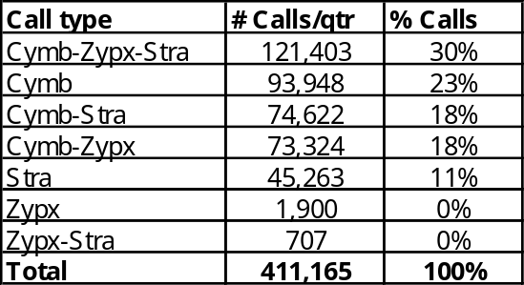
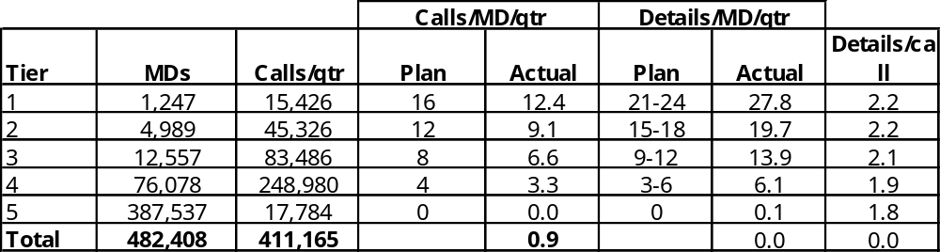
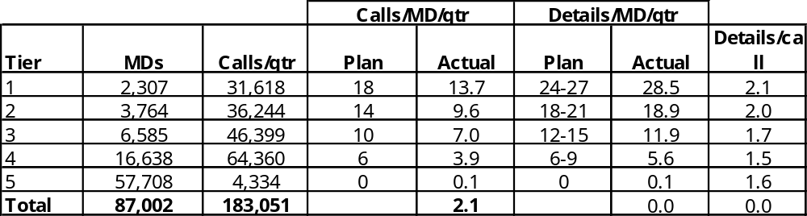
Calls Summary by Tier
NSPC
Of the NSPC calls, 88% of them had a Cymbalta detail, 59% had a Strattera detail and 48% had a Zyprexa detail
NS Psych
Of the NS Psych calls, 91% of them had a Cymbalta detail, 43% had a Zyprexa detail and 38% had a Strattera detail

Slide 22
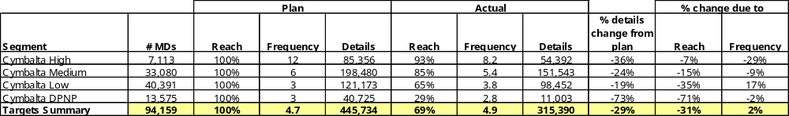
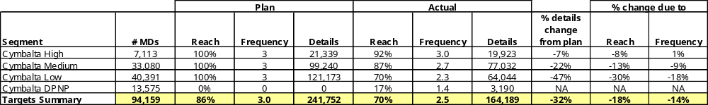
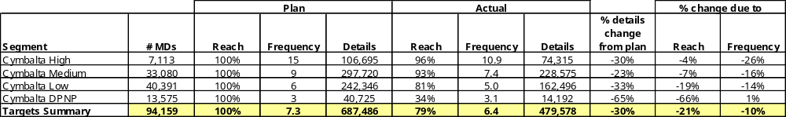
Cymbalta details to targets (NSPC and NQ)
NSPC
NQ
NSPC+NQ

Slide 23
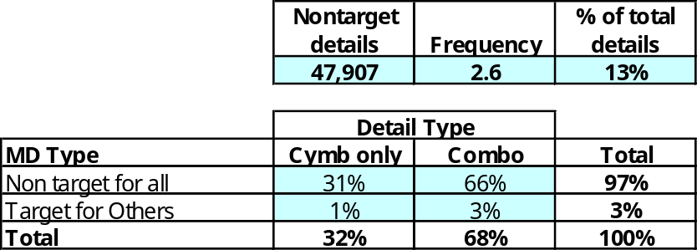
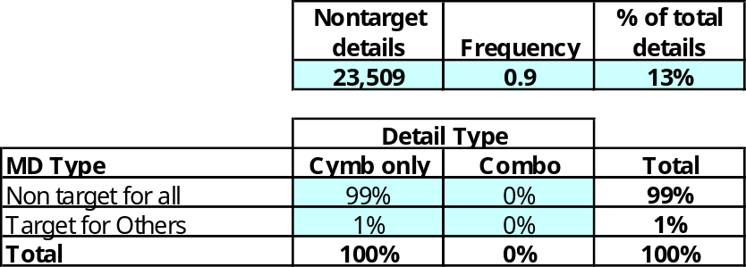
Cymbalta details to non-targets (NSPC and NQ)
NSPC
13% of Cymbalta details are going to Cymbalta nontargets
97% of Cymbalta nontarget details are to MDs who are not targets for any product
NQ

Slide 24
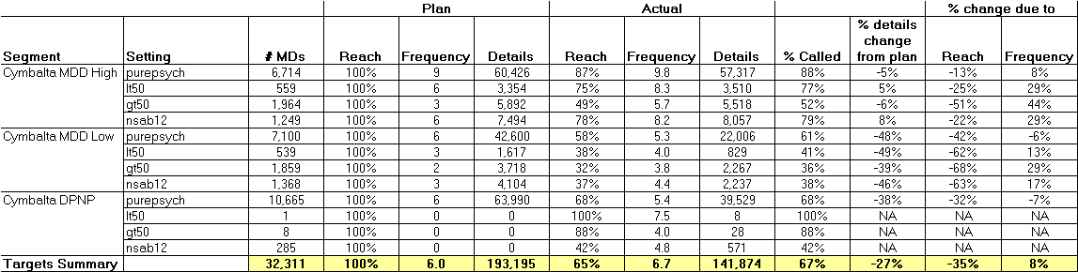

Cymbalta details (NS Psych Ofc)
Details to targets
Details to Non-targets

Slide 25

Cymbalta details (NS Psych Ofc,CMHC,NSABSO)
Details to targets

Slide 26
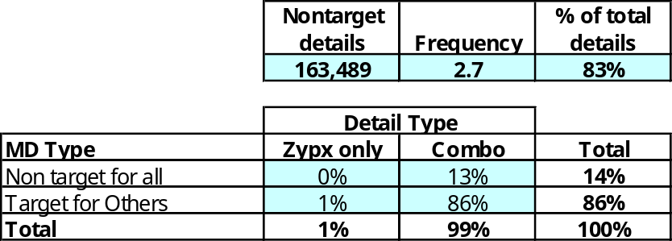
Zyprexa details (NSPC)
Details to targets
Details to Non-targets

Slide 27
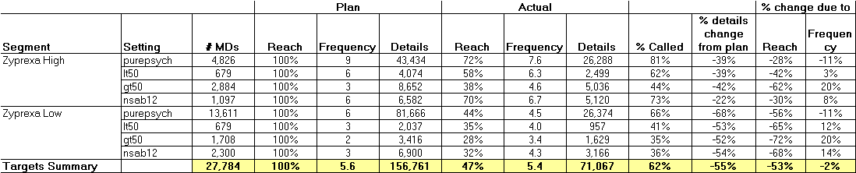
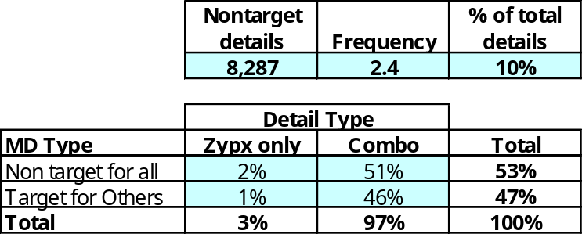
Zyprexa details (NS Psych Ofc)
Details to targets
Details to Non-targets

Slide 28
Zyprexa details (NS Psych Ofc, CMHC, NSABSO)
Details to targets

Slide 29
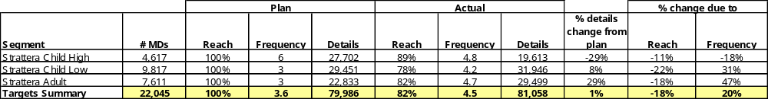
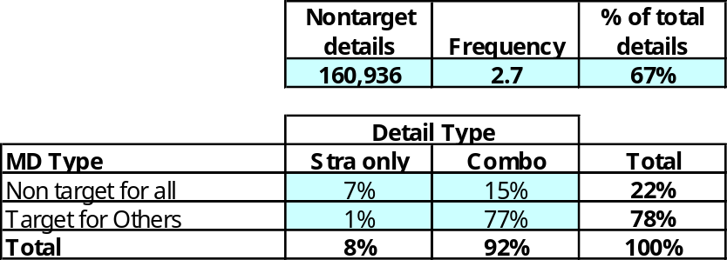
Strattera details (NSPC)
Details to targets
Details to Non-targets

Slide 30
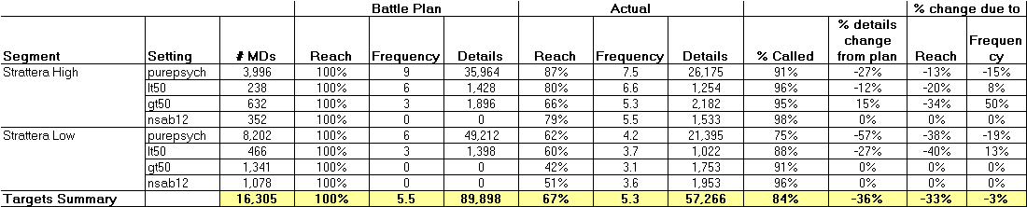
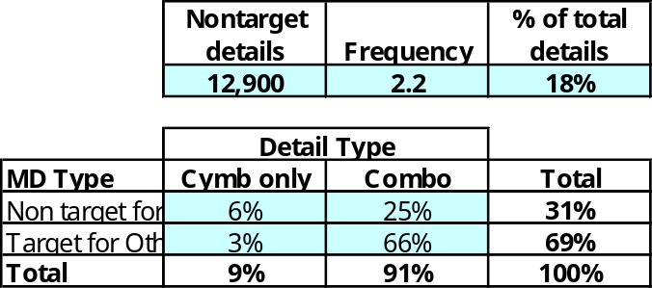
Strattera details (NS Psych Ofc)
Details to targets
Details to Non-targets

Slide 31
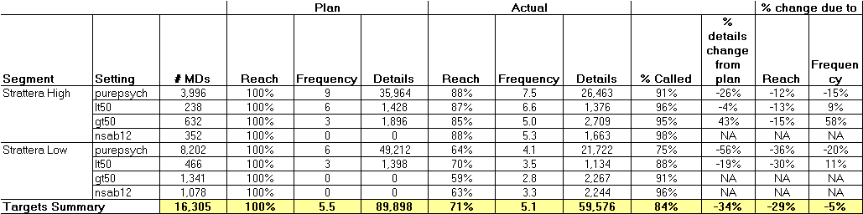
Strattera details (NS Psych Ofc, CMHC, NSABSO)
Details to targets

Slide 32
Targeting Recommendations

Slide 33
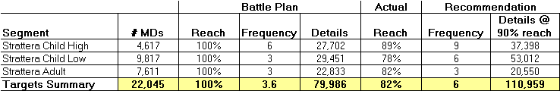
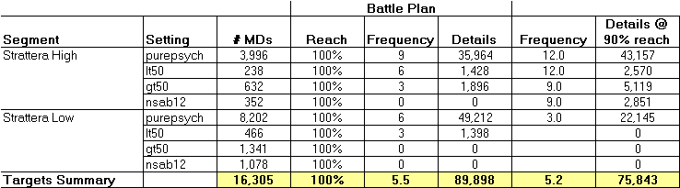
Strattera Recommendation
  NSPC should put more effort on Strattera than 2006 plan, NS Specialty should put less
  More focused approach in NS Specialty
NSPC
NS Spec

Slide 34
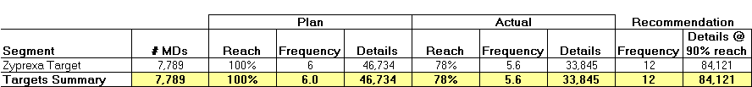
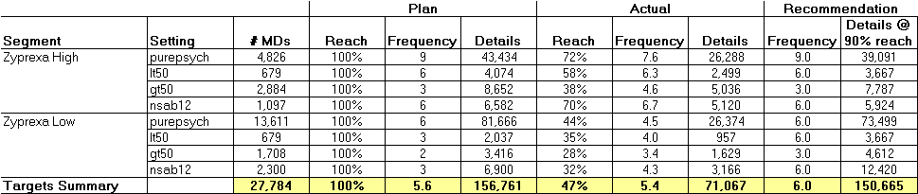
Zyprexa Recommendation
  Slightly fewer details in NS Spec, but more focused effort in NS Specialty
  More effort in NSPC
NSPC
NS Spec

Slide 35


Cymbalta Recommendation
  Fewer details in NSPC, and more in NS Specialty
  Would need to utilize NQ more effectively (not just blanket coverage)
NSPC
NS Spec

